Slide 1
Sports Taping
By: Emily Klein

Slide 2
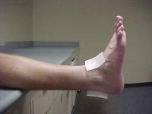
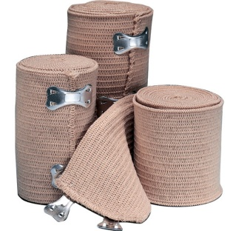
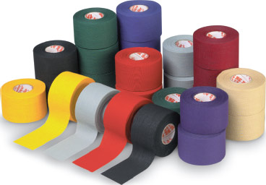
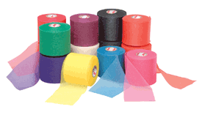
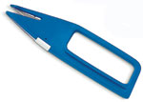
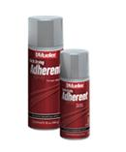
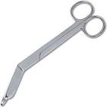
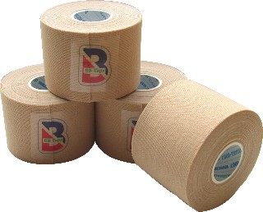
To Get Started…
Friction Pads
Athletic Tape
Shark Tape Cutters
Medical Lister Scissors
Items Needed:
Elastic Wrap
Pre-Wrap
Adhesive Spray
Elastic Tape

Slide 3
Tape Tearing, Cutting, and Removing
Tearing:
- Place fingers close together and make quick snapping motion in the opposite direction
-If tape becomes folded or crimped, move fingers away from folded area and try again
Cutting:
-Use surgical scissors with blunt tip, or tape cutters
-Cut tape where it tends to be loose because of the anatomical configuration of the body part
- Cut in an area with minimal bone prominents
Removing:
- Use one hand to support/compress skin
-While using the other hand to slowly remove the tape by pulling in the opposite direction to the stabilized skin

Slide 4
Taping Techniques for the Lower Body

Slide 5
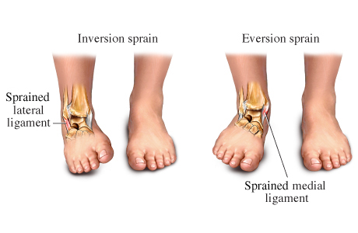
Check for Type of Sprain:
Degree of Sprain:
First Degree-Pain, mild disability, point tenderness, little laxity, little or no swelling
Second Degree- Pain, mild-moderate disability, point tenderness, loss of function, some laxity, mild-moderate swelling
Third Degree- pain and severe disability, point tenderness, loss of function, laxity, moderate-severe swelling

Slide 6
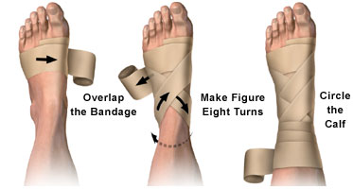
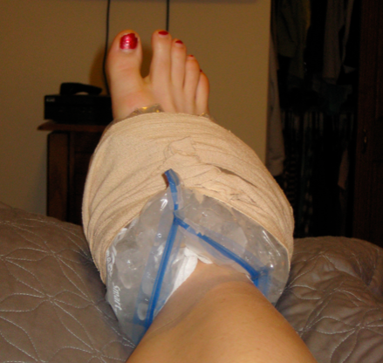
For an Acute Ankle Sprain:
Apply Compression with and Elastic Wrap
May also use horseshoe pad with elastic wrap
Apply Ice with Elastic Wrap for 20 mins/hour

Slide 7
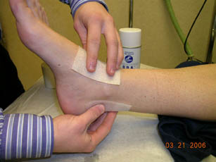
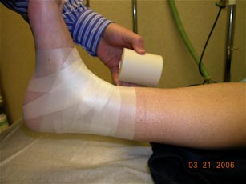
Before You Begin:
Apply adhesive spray to the entire ankle
Apply friction pads over boney prominents and tendons
Apply Pre-Wrap to avoid irritation
Throughout entire taping process, make sure ankle is kept at 90º

Slide 8
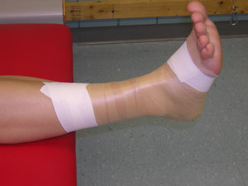
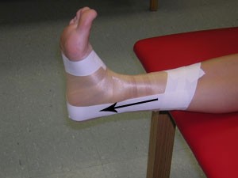
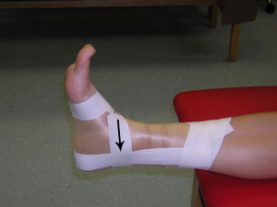
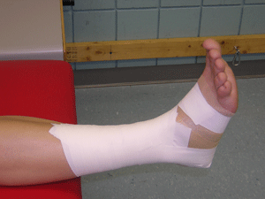
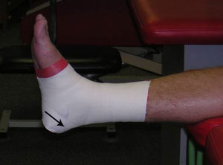
Closed Basket Weave (Inversion)
Using athletic tape, place two anchor strips (one above ankle, the other at the base of the foot leaving the toes exposed)
Apply stirrup strip from medial to lateral side
Apple horseshoe strip from medial to lateral side
Repeat two more stirrup and horseshoe weavings
Enclose the leg with horizontal strips
Apply heal locks

Slide 9
Closed Basket Weave (Inversion)
For support with less restriction, you can use both athletic tape and elastic tape
Using athletic tape, place two anchor strips (one above ankle, the other at the base of the foot leaving the toes exposed)
Apply stirrup strip from medial to lateral side
Then with elastic tape, apply figure-8 and heal lock
Enclose ankle in circular motion with elastic tape
Have the option to repeat heal locks and figure-8 with athletic tape
For more support, use a moleskin stirrup before applying the closed weave basket
Then follow the steps for closed weave basket with either athletic tape or elastic tape

Slide 10
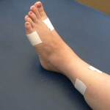
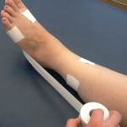
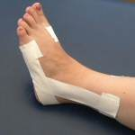
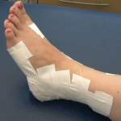
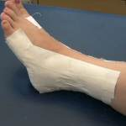
Open Basket Weave (Eversion)
Apply anchor strips while leaving the front open
Apply stirrup strip from lateral to medial side
Weave strips along with stirrup strip
Enclose ankle with horizontal strips still leaving the front open
Apply single heal locks
Then apply anchor strips on anterior portion and dorsum
Apply 3 horizontal strips across the top of the foot to secure the procedure
1. Above Ankle
2. Ankle Joint
3. Base of Foot leaving toes open
Finally, use elastic wrap to enclose ankle completely. Use fasteners or tape to secure wrap

Slide 11
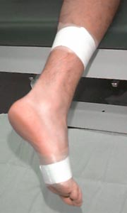
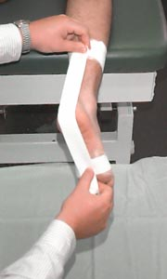
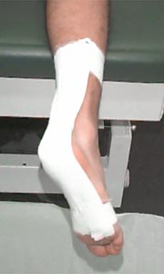
Achilles Tendon
Apply friction pad on Achilles tendon, and wrap ankle with pre-wrap to avoid irritation
Apply anchor strips proximally and distally
Place 3 strips in an “X” like fashion to limit dorsiflexion with elastic tape
Apply another set of anchor strips proximally and distally
Secure the entire procedure by applying heal locks and figure-8 with elastic tape
Supplement the procedure with a heal lift

Slide 12
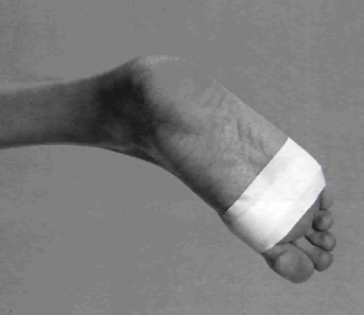
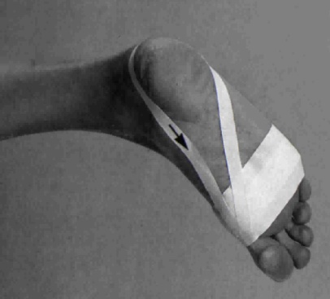
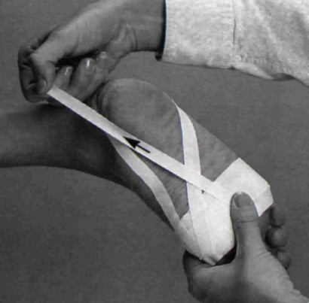
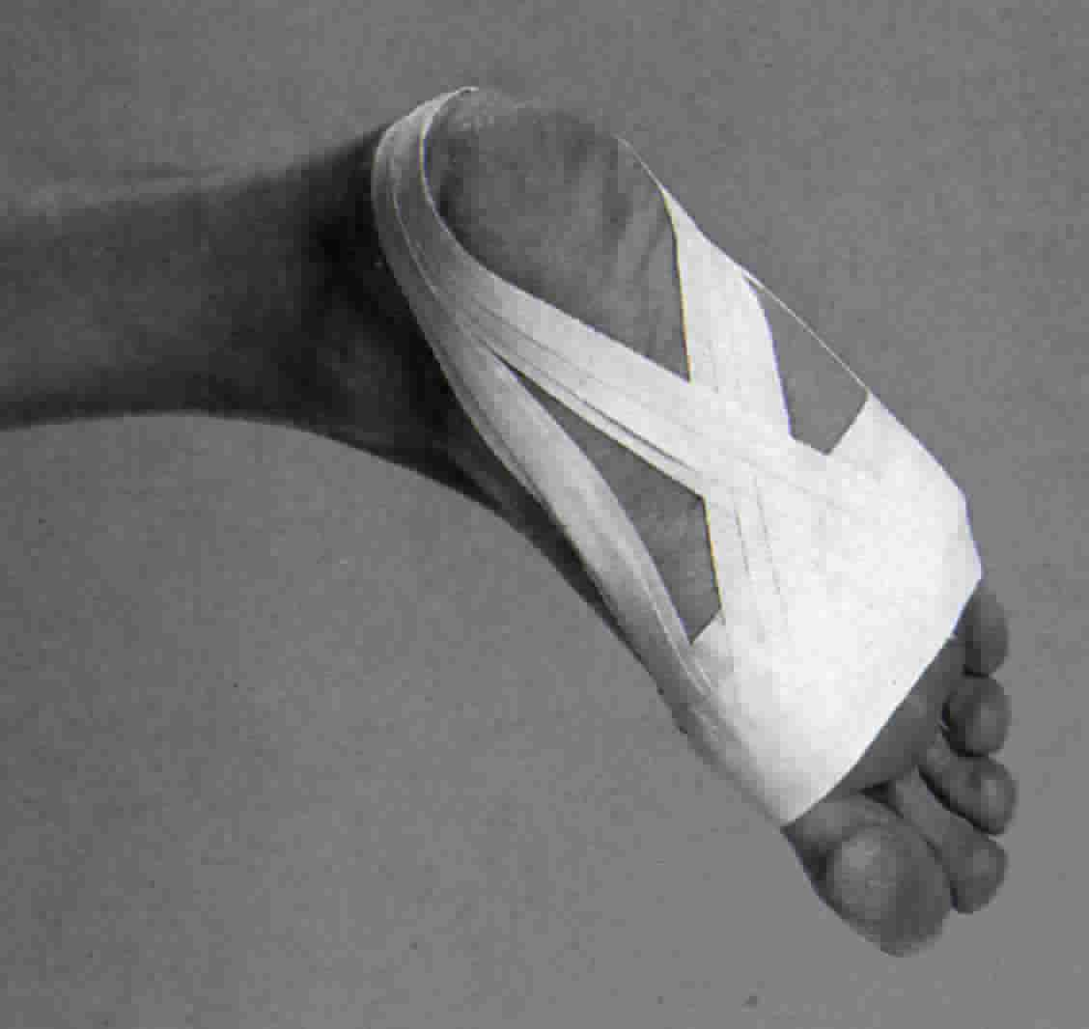
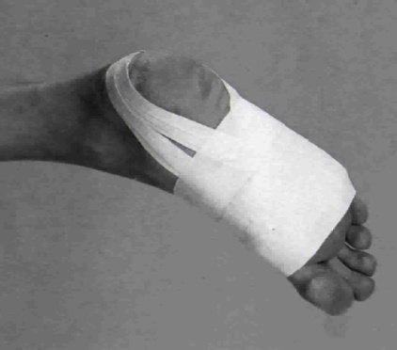
Longitudinal Arch
Apply anchor strip near the toes
Apply 3 strips starting at the base of the toe, wrapping around the heal and finishing where the procedure started
With 3 more strips, start at the base of the toe and wrap around the outside of the heal and back to where the procedure started. This overlaps the strips in the previous step.
Place 3 or 4 strips around the arch of the foot to finish the procedure

Slide 13
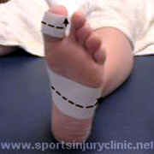
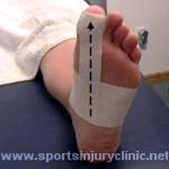
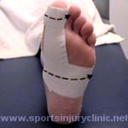
Great Toe Sprain
Hyperextension:
Apply anchor strips mid-foot and on great toe
Apply strips on the plantar surface
Secure procedure with anchor strips mid foot and great toe
Hyperflexion:
Same steps as hyperextension
Apply 3 strips to the top of the foot
Secure the procedure with anchor strips around mid-foot and great toe

Slide 14
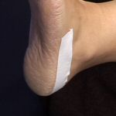
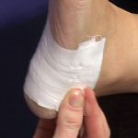
Bruised Heel
Apply anchor strips around the back and bottom of the heel
Apply strips in a weave pattern until the heel is completely covered

Slide 15
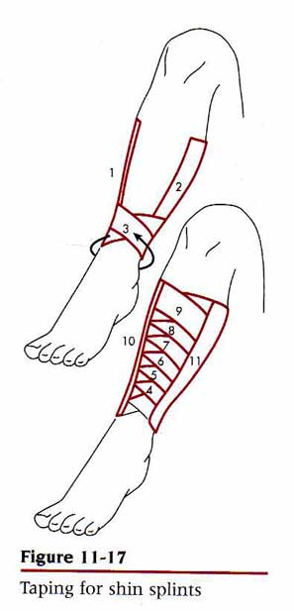
Leg-Shin Splints
Apply proximal and distal strips
Apply medial and lateral anchor strips
Apply strips in an overlapping oblique fashion, pulling lateral to medial and medial to lateral
Completely cover the anterior aspect of the leg
Apply proximal, distal, lateral, and medal anchor strips to complete the process

Slide 16
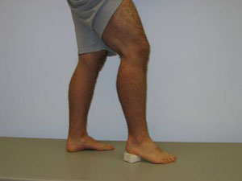
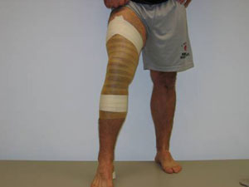
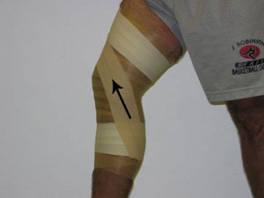
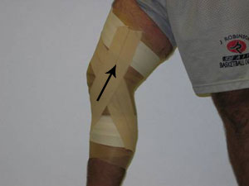
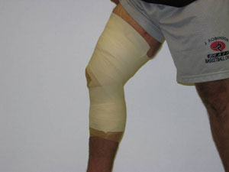
Knee- Collateral Ligament
Before taping, place a heel lift under the athlete’s foot
Apply anchor strips with athletic tape above and below the knee with equal distance from the knee
With elastic tape, make an “X” over the medial side of the knee
Place a strip of tape over the “X”
Do the same on the lateral side of the knee
Apply anchor strips above and below the knee
Finish the procedure by enclosing the calf and thigh with elastic tape, leaving the patellar region open
Using athletic tape, place a strip above and below the knee

Slide 17
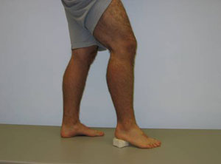
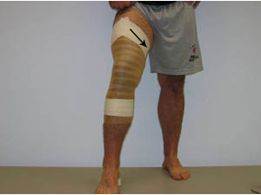
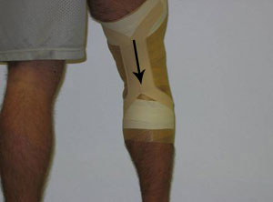
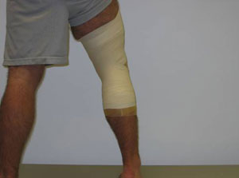
Knee Hyperextension
Place a heel lift under the athlete’s foot
Apply anchor strips above and below the knee with equal distance from the knee
Make an “X” on the back of the knee, and secure the “X” with a single strip across the “X”
Apply anchor strips above and below the knee
Enclose the leg and thigh with elastic wrap
Secure the procedure with athletic tape around the end of the elastic wrap

Slide 18
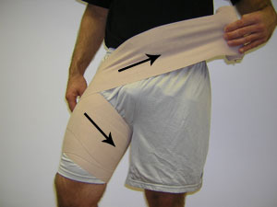
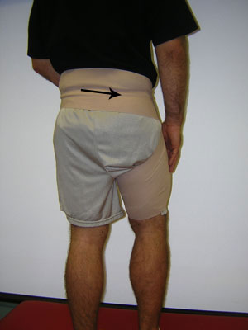
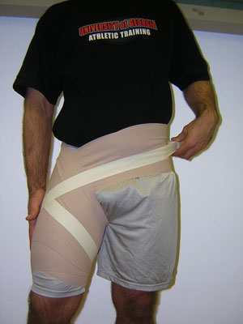
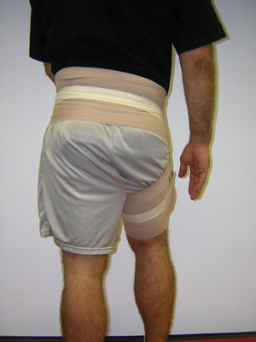
Hip-Spica
Adductor:
Place hip in an internally faced position
Apply elastic wrap by pulling the hip muscle to an internal rotation and continue the wrap around the waist
Then use elastic tape to trace the elastic wrap in the same direction as the elastic wrap
Abductor:
Place hip in an externally faced position
Apply elastic wrap pulling muscle to external rotation and flexion and continue wrap around the waist
Use elastic tape to trace the elastic wrap in the same direction as the elastic wrap

Slide 19
Thigh-Quad Strain
Apply tape adherent, or roll a strip of tape and apply it to the thigh before you apply the elastic wrap
Apply elastic wrap in a circular motion around the thigh
You can also you athletic tape below using the wrap
Apply anchor strips proximal, distal, medial and later of the thigh
Apply oblique strips pulling lateral to medial and medial to lateral
Apply another set of medial and lateral anchor strips
Secure procedure with elastic wrap

Slide 20
Thigh-Hamstring Strain
Wrap the thigh with elastic wrap
For medial strain; wrap from the inside to outside of the thigh
For lateral strain; wrap from outside to inside of the thigh
Use Hip-Spica to prevent slipping and provide extra support for hamstring
Trace over wrap with elastic tape

Slide 21
Taping of the Upper Extremities

Slide 22
Shoulder-Separation
Apply anchor strips to superior, anterior and posterior in aspects to the shoulder region as well as the proximal arm
Apply a strip from the arm anchor to the superior shoulder anchor
Apply a strip from the anterior to the posterior anchors in an overlapping fashion
Apply another set of anchor strips
Secure a protective pad using a shoulder-spica with an elastic wrap

Slide 23
Shoulder Sprain
Have the athlete rotate his shoulder inward and place their hand on their hip
Apply an elastic wrap around the arm, and continue with a shoulder-spica around the chest
Be careful not to wrap to tightly to cut off circulation
Pull the wrap to the inside to limit rotation
Trace over the procedure with elastic tape

Slide 24
Elbow Instability
Apply proximal and distal anchor strips
Place tape over the medial collateral ligament in an “X” fashion
Apply another set of proximal and distal anchors
Using elastic tape, enclose the arm leaving the elbow region open

Slide 25
Elbow- Hyperextension
Determine the degree of injury so you can tape in the athlete’s pain free zone
Have the athlete support his elbow during the taping process
Using elastic tape, place an anchor strip on the upper arm and forearm
With athletic tape, make an “X” over the crook of the elbow
Apply an additional set of anchor strips with the elastic tape
Wrap the entire procedure in elastic wrap
Secure the procedure with athletic tape

Slide 26
Wrist Sprain
Place anchor strips around the wrist and hand
Place 3 strips or tape on the top of the hand
Make an “X” on the top of the hand
Then repeat the same process on the bottom of the hand
Place additional anchor strips around the wrist and hand
Using elastic tape, apply two figure-8’s around the wrist
Secure the procedure with an anchor strip around the wrist using athletic tape

Slide 27
Thumb Sprain
Place an anchor strip around the wrist using athletic tape
Apply figure-8’s around the thumb joint
Apply an additional anchor strip around the wrist
For an athlete who needs more support, you can apply an anchor strip around the hand
Apply overlapping strips from the bottom of the hand around to the top of the hand
Secure these strips using elastic tape and make figure-8’s around the thumb joint
Finish the procedure with anchor strips around the hand and wrist

Slide 28
Finger Sprain
Wrap tape around the injured finger and an adjoining finger near the base of the two fingers
Apply another strip around the tips of the fingers leaving the joint open

Slide 29
Finger Collateral Ligament
Apply anchor strips on both sides of the injured joint
Place an “X” over the collateral ligament
Do the same on the other side
Apply two more anchor strips

Slide 30
In Conclusion…
The key to mastering these taping procedures is practice
By doing so you will be able to minimize your athlete’s and clients recovery time

